Slide 1
Subject Political Economy (PPS 2108)
Lecturer: Mr. Boriboon Chalong (Ajarn NUM)
Tel.062319-9591, e-mail: Boriboon.ch@ssru.ac.th, https://cpg.ssru.ac.th/th
College of Politics and Government
Suan Sunandha Rajabhat University

Slide 2
Course Description PPS2108
To study political economy world ,capitalist system by analyzing policies, roles and behaviors of the state.
Interstate union economic relations, trade, investment including the influence of various powers as well as issues that affect government policy.

Slide 3
Chapter 1: Introduction
Chapter 1: Introduction
Mainstream economics / Secondary Economics.
Macro Economic / Micro Economic
Factors of Production/ Basic Economics Problems
Economic Systems
Economic Unit

Slide 4
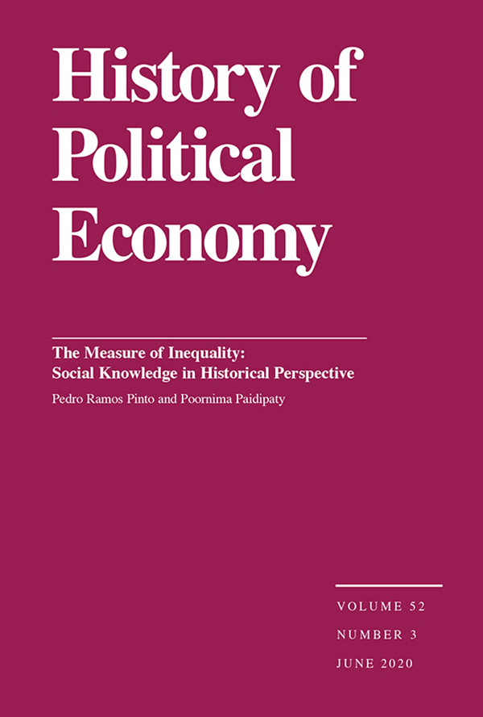
Chapter 2: Evolution
Chapter 2: Evolution
1. The formation era of the study of political economy
2. The booming era of political economy studies
3. The decline era of the study of political economy
4. The revival era of the study of political economy

Slide 5
Chapter 3 : Definition
Chapter 3 : Definition
The First Definition
The Second Definition
The Third Definition
Conclusion

Slide 6
Chapter 4: Scope of Political Economy.
Chapter 4 : Scope of Political Economy.
1) Neo-Marxist approach (Neo-Marxist)
2) Public Choice
3) Institutionalism (Institutionalist)

Slide 7
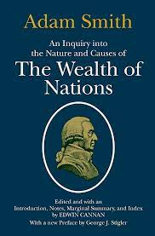
Chapter 5: Adam Smith and Political Economy Concepts
The Concept of economic growth and development
Invention VS Innovation
Economic Policy
Tax Policy
Conclusion of classical school of economics

Slide 8
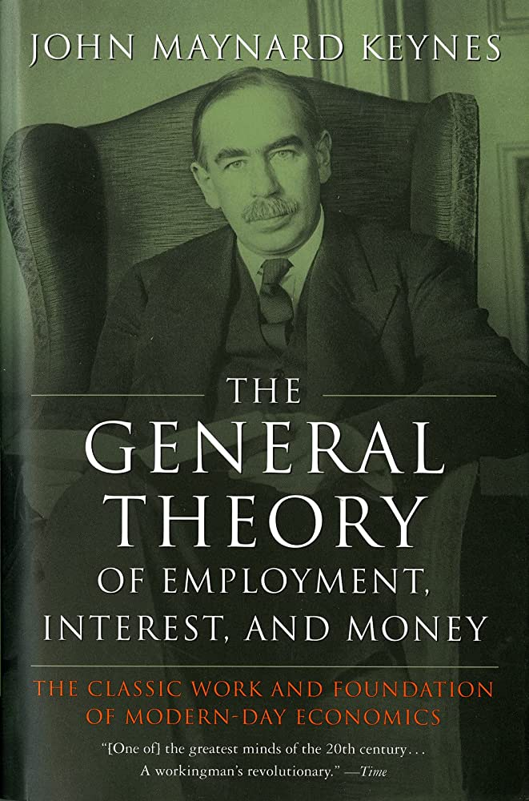
Chapter 6: John Maynard Keynes with macroeconomic concepts
Macro Economic Concepts
Cash and commodity flow model
Classical Theory of Unemployment
John Maynard Keynes with Macro Economic Concepts

Slide 9
Chapter 7: Problems of social science study of mainstream ideas about state, development, and international relations.
Pluralism.
The Role of the State in Pluralistic education.
Weaknesses of pluralism
Developing with the study of modernization concepts.
Development Model
Criticisms from academics
International Political Economy and International Politics and international economy

Slide 10
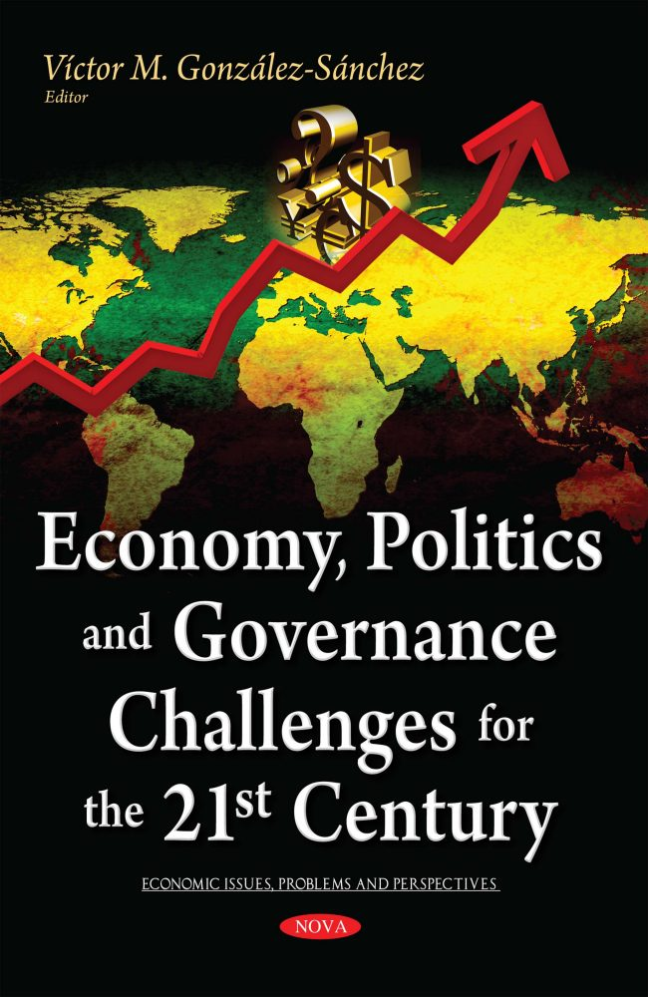
Chapter 8: Mainstream Economics (Neoclassical economics
Challenges from Political Economy Concepts
Mainstream Economics Concepts
Marxism Concept
Perspective on Human Nature
Politic : the Law allows
The free market and the real world

Slide 11
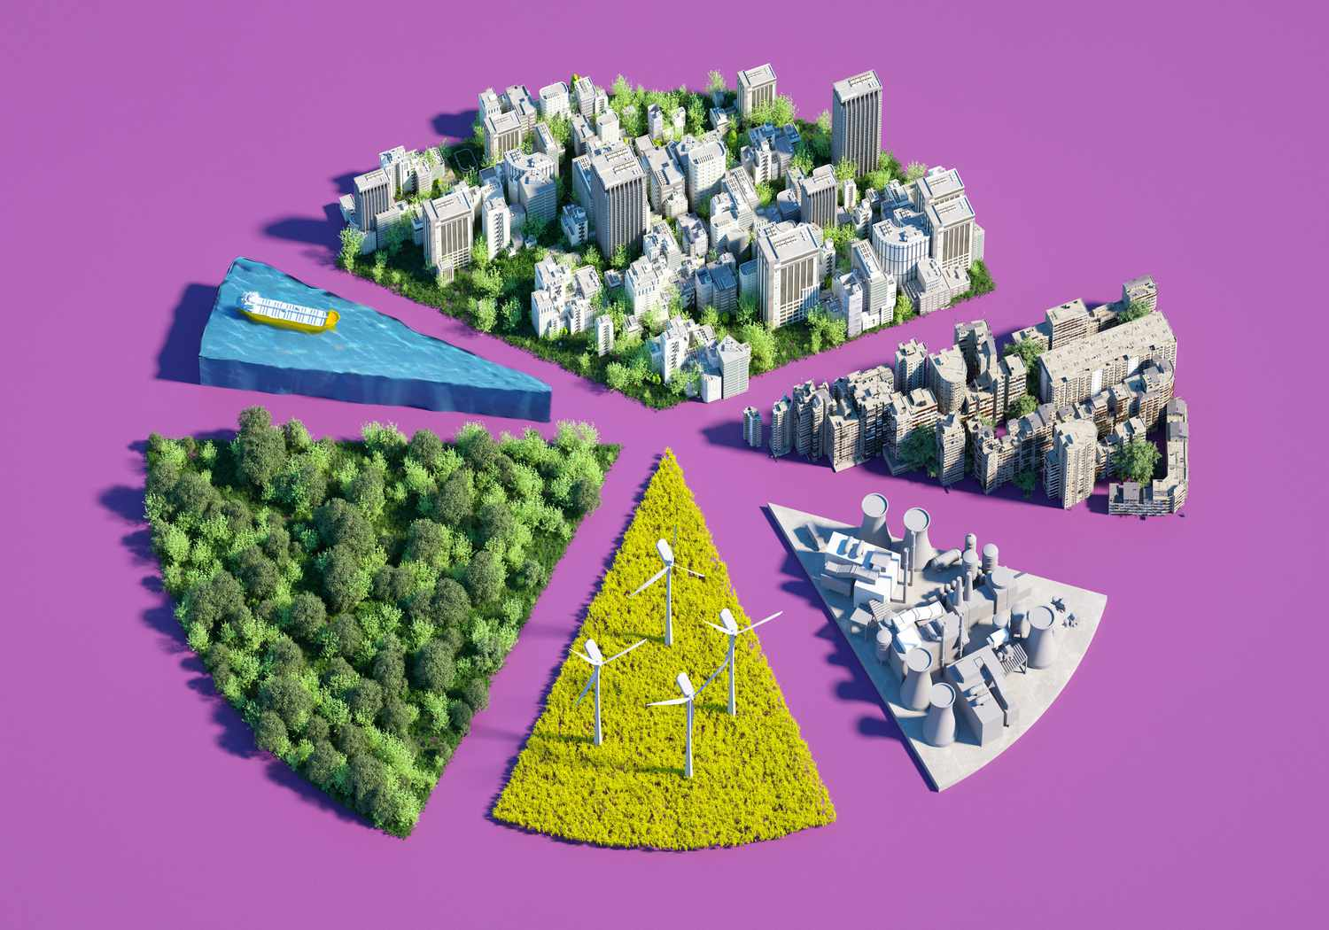
Chapter 9: Public Choice Theory
Public Choice Concept
The Main Hypothesis of Public Choice Concept
Political Business Cycle Model
Political Economy Model
Evaluation Function
Reaction function

Slide 12
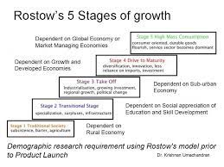
Chapter 10 : Modernization Theory
Modernization Theory Concept
Development Theory
Stages of Growth
The Important Elements of Modernization Theory
The Essential elements of Modernization Theory
The weakness elements of Modernization Theory

Slide 13
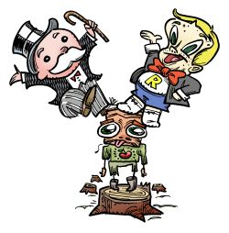
Chapter 11: Dependency Theory
Background
Definition of Dependency
Term of Dependency
Goal of Dependency
Breaking free from dependency (Neo Marxism)
Conclusion of Dependency Theory

Slide 14
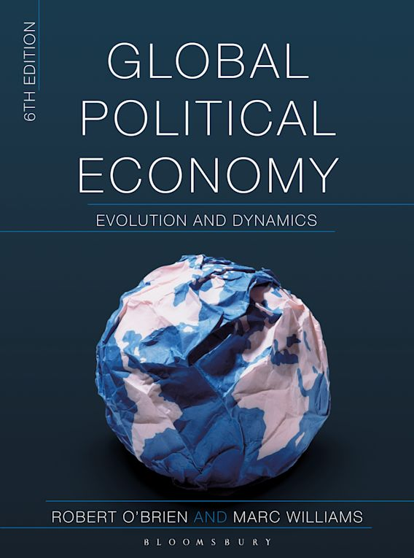
END

