Slide 1
Money Supply
Each country uses money as a medium of exchange of various kinds. Some species are widely accepted in one country. But it may not be popular in another country.
Therefore, counting the money supply (Money Supply) can be classified into 2 meanings:
1. Narrow money is the amount of money by taking into account the role of money as a medium of exchange only.
The symbol M1 is used instead. Definition
Including banknotes and coins in the hands of the public (not including those in the hands of depository institutions)
and current deposits of the private sector (Not counting those in the hands of the Central Bank and the Ministry of Finance)

Slide 2
2. ปริมาณเงินตามความหมายกว้าง (Broad Money) เป็นการนับปริมาณเงินโดยคำนึงถึงบทบาทของเงินฐานะที่เป็นสื่อกลางแลกเปลี่ยนและการเป็นเครื่องรักษามูลค่าด้วย
มีการใช้สัญญาลักษณ์อื่นๆ เช่น M2 M3 เป็นต้น
กำหนดขึ้นแทนคำนิยามที่มีการนับรวมสินทรัพย์ทางการเงินให้ผลตอบแทนอื่นๆ นอกเหนือจากปริมาณเงิน M1 เช่น
M2 = M1 + เงินฝากออมทรัพย์ และเงินฝากประจำของภาคเอกชนและรัฐวิสาหกิจที่ธนาคารพาณิชย์
M3 = M2 + ตั๋วสัญญาใช้เงินของบริษัทเงินทุนที่ถือโดยภาคเอกชน (เนื่องจากรัฐบาลไม่อนุญาตให้บริษัทเงินทุนทำธุรกรรมรับฝากเงินเหมือนธนาคารได้ ในทางปฏิบัติบริษัทเงินทุนจึงใช้วิธีดึงเงินออกจากลูกค้า ด้วยการกู้ยืมเงินจากลูกค้าในรูปของการออกตั๋วสัญญาใช้เงินให้ลูกค้าแทนสมุดเงินฝากของธนาคาร)

Slide 3
The choice of the definition of the money supply depends on the decision of the country's government or bank. which depends on the suitability of economic and financial conditions in each period, for example
developing country The economic system and financial markets are not very well developed. Use a narrow definition that only considers the role of money as a medium of exchange.
developed country The financial market has evolved a lot. There are many types of popular financial assets. Use the definition in a broad sense.

Slide 4
Summarize
Money is what allows humans to exchange goods and services quickly and easily.
It is also a measure of value. preserve the value and a better future moratorium than direct exchange.
Money must have good attributes. must be generally accepted stable in value and easy to carry around
The value of money will change depending on the price level and exchange rate.
As for counting the general money supply, it ranges from a narrow meaning, such as banknotes, coins, and current deposits. to a broader sense that includes credit developed in the modern market
The supply of money available to the economy depends on the policies of the central bank. The demand for money arises from the desire to spend. Use in an emergency and for speculation

Slide 5
Financial System
type of currency
Types of currency that have been used since the past to the present. Divided into 3 types of income:
1. Full-bodied money
Denominated money is money that has the metal value equal to its monetary value, e.g. 1 dollar is equal to 24.75 grains of pure gold.
In the past, money with full value was commodity money such as leather, fur, etc., and metal money such as gold.
The amount of money on the coin is equal to the value of the metal used to make the coin.

Slide 6
2. money used in place of full-value money (Representative Full-bodied Money)
Money that represents full value of money has been developed in line with economic growth, such as Goldsmith Certificates, Bank Notes, etc.
Made of paper that can always be exchanged for coins or metal of full value. Because it is a piece of paper that has no value. but only a cash equivalent, such as a former US bank card that can be redeemed for $55 or for gold or silver equivalents, etc.

Slide 7
3. Credit Money
Credit is money that has no full value. Or money whose value as currency is higher than the value of the material used to make money, such as banknotes, coins, etc., is still used today.
In general, credit money is classified into 3 types: coin money, paper money, and account money.
1. Token Coin
A coin made of metal whose monetary value is higher than the metal used to make the coin. Usually the government produces mint money. In order to be change or a small unit of money to facilitate the purchase of goods and services that have little value, such as

Slide 8
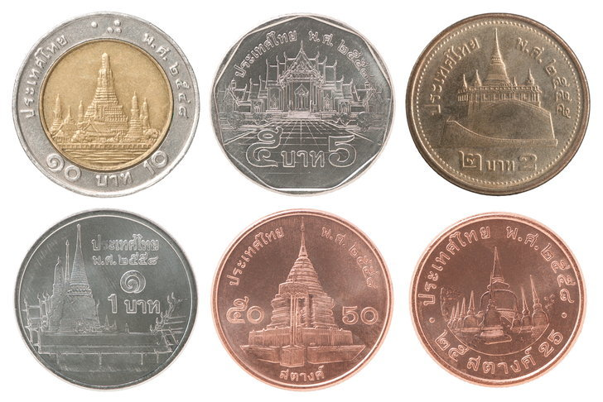

Slide 9
Coins produced by the government are made of metal, and the weight and purity of the metal used to make each type of coin are determined. And there is a stamp for beauty and prevention of counterfeiting. The criteria used in the production of coins are as follows:
1) It should be difficult to forge by having patterns, stamps.
2) It should be made of fairly solid metal. so as not to wear easily
3) It should be round and flat. suitable size and convenient to carry
4) Difficult to scrape off precious metal

Slide 10
2. Paper Money
It's money made out of paper. which the monetary value is higher than the value of the paper that is used to make money Currently, the right to issue paper money is issued by the government or the central bank, called "banknotes", which have a partial value and cannot be exchanged for metal (Fiat Money), but are only banknotes that can be legally paid. (Legel Tender)
3. Scriptural Money
This type of money is a credit that occurred during the modern economy where the banking and financial system has developed a lot. "Current deposits" which are created by the commercial banking system.
Nowadays, credit is widely accepted and used in accordance with the expansion of trade and investment that are traded in bulk. Because current deposits are made payable by check. is safe It is more convenient and faster than using coins or paper money. And can also be endorsed and transferred to other people according to the conditions specified by law, however, this type of money is not the money that can be legally repaid The creditor can then refuse to receive payment by check.

Slide 11
(Monetary Standard)
means "rules or regulations established The main currency standards that have been used in the world's financial system from the past to the present can be classified into 3 types: Metallic Standard, non-metal-based currency standard. valuable (Non-Metallic Standard) The currency standard under the International Monetary Fund. (International Monetary Fund Standard or IMF)

