Slide 1
Bitcoins
It is a digital currency created by the internet system. To be used as money in the information technology world (cyberspace), this currency is called bitcoin or has other names such as virtual money or cryptocurrency.
Bitcoin is a currency or currency that is used to trade things over the Internet. It has its own exchange rate with other currencies, for example 1 Bitcoin = 140 US dollars. Bitcoin has become one of the currencies in the world. There are countries that use this Bitcoin currency, which is a country where online shopping does not have a national bank. There are approximately 11.75 million bitcoins circulating in the global economy as of October 2013.

Slide 2
The evolution of money in Thailand
1. Pre-Sukhothai period
Thailand has been using currency as a medium of exchange for a long time. since the Sukhothai period with evidence appearing in the Kingdom of Funan Which has a prosperous story during the 6th-11th Buddhist century, where the money used looks like a flat silver coin There are motifs that have been influenced by the monarchy and Brahminism of India.
The pattern of the coin found on one side depicts a radiating half sun. There are 2 rows of ellipses, the other side has the symbol of Srivatsa. which is the symbol of Vishnu in the middle On one side of the srivatsa is a banda, meaning a small box used by brahmins in various ceremonies. on the other side is a swastika The top of the coin depicts the sun and moon. The motifs appearing on the coins show the Brahmin beliefs of the ancient Indians.

Slide 4
Later, during the Dvaravati Kingdom period At that time it was the time when Khmer was in power. The Dvaravati Kingdom has accepted the beliefs of Khmer as well. The currency used as a medium of commerce therefore has patterns and symbols related to the king. State power and fertility according to the beliefs of Brahmanism and Buddhism The Dvaravati coin is important. A large conch-shaped coin, a small conch-shaped, a rabbit, a lotus, and a goat. There are ellipses around the edge of the coin. On the other side, there is a symbol of Sri Vatsa. flanked by Angkut (an elephant) at the top, there are images of the sun and moon Below is a picture of a fish.
In addition, coins were found that are round and flat. There are various motifs such as Puranakolsa (water boiler), Thammachak, cow, on the other side, there are ancient Sanskrit characters, etc.

Slide 6
2. Sukhothai period
There are many types of money used in the Sukhothai period according to the prosperity of the various kingdoms. in power at that time which may be classified into 3 periods: money in the Lanna period Lan Chang and Sukhothai periods
Money in the Lanna period was called "Jiang money". It resembled the shape of 2 horseshoes connected together, so it was often called pin-knuckle money. In the Lan Chang period, there were four types of money used: Cabinets, both of which are made of silver metal in a rectangular bar. 3) Hoy silver, made of silver mixed with copper and brass. 4) Lad silver, made of copper mixed with brass.

Slide 7
There are 3 types of money used in the Sukhothai period:
1) Money made from shells imported from foreign countries.
2) Pod Duang money, made of metal, looks like a circle bent together like a beetle. There are seals in the form of elephants and conch shells.
3) Plated silver looks like Pod Duang silver. but made of pewter There is a seal with the image of an elephant and a royal palace.

Slide 8
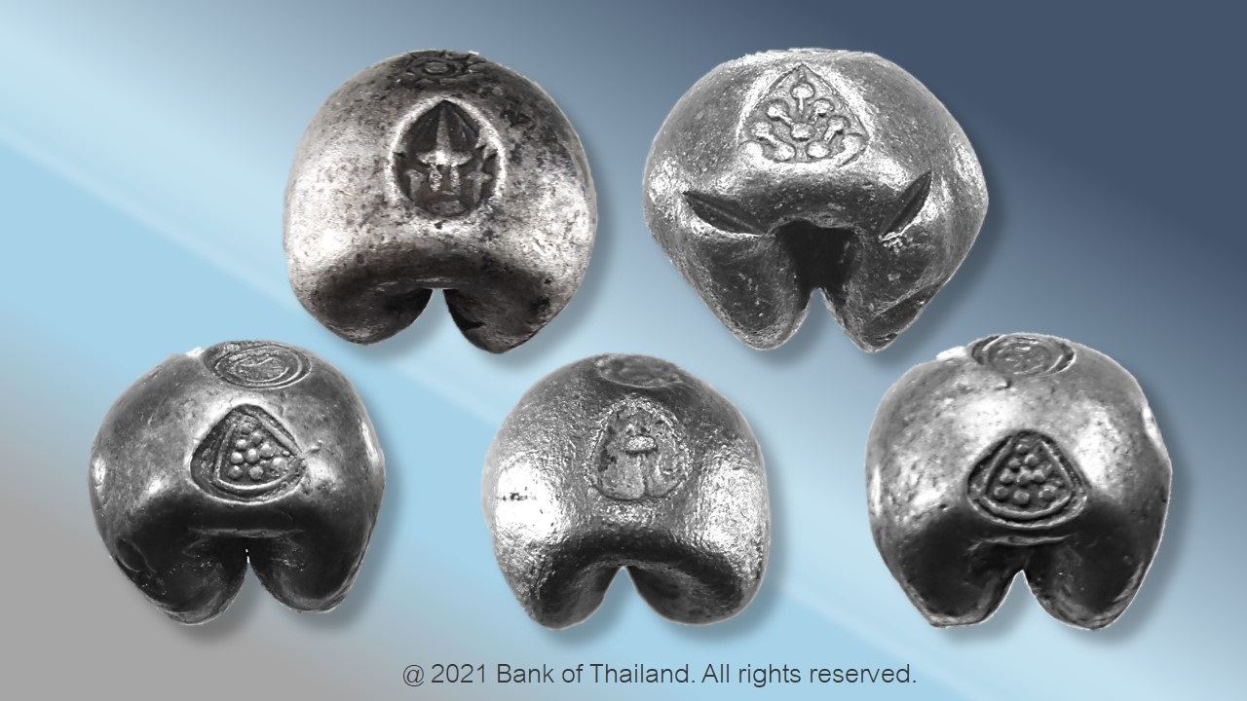

Slide 9
3. Ayutthaya period
There are 3 types of money that have been brought out, namely the money, the Pod Duang, and the pak.
The first two types of money are similar to the Sukhothai period in all respects. There are differences in the names or stamps of each type of money. By money used in the Ayutthaya period These are shells brought from abroad, including Bia Chan, Bia Kae, Bia Nang, Bia Moo, Bia Bua, and Bia Tum.
For stamps in Pod Duang money of the Ayutthaya period, such as the Thammachak seal, the Sangha seal according to Garuda, the lotus seal, the Nang Hong seal, etc.
As for the allowance It will be the money that will be used instead of premium money in times of shortage. It is made of terracotta and stamped with images such as lotus flowers and lions.

Slide 10
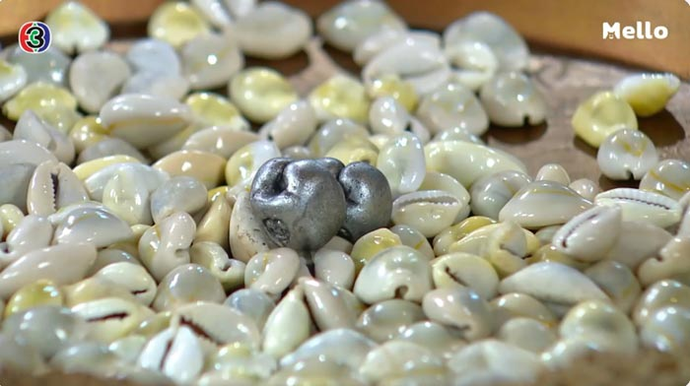

Slide 11
4. Rattanakosin Era
In the early period of the Rattanakosin period, the currency used Still have the same characteristics as the Ayutthaya period, such as Pod Duang money, which is different on the seal The crescent garuda and crown emblem of the Rattanakosin period, etc.
Until the reign of King Rama IV, King Mongkut ordered the creation of a mint to produce coins for the first time in the year 1860, with the name "Pae money". ” It has a round, flat front with a crown stamped on it. Behind the machine seal

