Slide 1
1. (Metallic Standard)
Popularly referred to as the Metal Standard for short, is a monetary system that uses precious metals as a standard for determining the value of money, divided into 2 main sections as follows:
Monometallic Standard
Bimetallic Standard

Slide 2
มาตรฐานเงินตราที่อิงโลหะมีค่า (Metallic Standard)
มาตราโลหะเดี่ยว
มาตราโลหะคู่
มาตราโลหะทองคำ
มาตราโลหะเงิน
มาตราโลหะคู่ขนาน
มาตราโลหะคู่ซ้อน
มาตราเหรียญทองคำ
มาตราทองคำแท่ง
มาตราปริวรรตทองคำ

Slide 3
1. Monometallic Standard
Single Metal Article refers to a monetary system that uses one type of precious metal as a standard for determining the value of money, i.e. gold and silver.
Gold Section
A monetary system that uses gold as the standard for determining the value of money. England was the first country to be used in the year 1821 and has been used in many countries such as Portugal, the United States.
The Golden Section has begun to lose public confidence. And was eventually canceled in the 1930s by the gold section that had been used, consisting of the gold coin section Gold Bullion Standard Gold Exchange Standard

Slide 4
Gold Medal Section
Section stipulated that gold ingot must be compared to a certain number of coins in the production of each coin. It must be a gold coin with full face value. into circulation in the economy In order to keep the gold coins in circulation stable. people accept credibility It is absolutely necessary to have the following conditions:
1. Determine the gold value to minting coins in exact units that each coin will use the amount of gold used to produce the coin, how much it will weigh. with the same amount of weight for every coin
2. Allowing the production of gold coins without limitation and free of charge to prevent the market price of gold from being lower than the value of gold coins.
3. An unlimited number of gold coins can be melted into metal. To prevent the value of gold in the market is higher than the price of gold coins.
4. Specify that other types of money can be circulated in the financial system at that time. Can be exchanged for money, gold coins at the same value
5. Free import and export of gold This is to keep the gold price equal within and outside the country.

Slide 5
(Gold Bullion Standard
It was a clause that was adopted after World War I as gold was insufficient for the production of money. Therefore, this clause did not produce gold coins to be used as circulation money in the economy. Instead, it uses the method of referencing the value of the currency produced to be equal to gold.
By keeping gold bars as reserves to ensure the acceptance and credibility of the currency produced only The gold bar section has various criteria. can be summarized as follows
1. There is no making gold coins to circulate. By setting the currency of the country that produces it to be worth compared to gold by keeping gold bars as a reserve fund only
2. No money of any kind is allowed to be freely exchanged for gold. But there is only a limit on the amount and the exchange rate set by the government.
3. Allow free import and export of gold. so that the price of gold inside and outside the country is the same
4. The government buys unlimited amounts of gold. to keep the value of gold stable which maintains the value of the currency produced

Slide 6
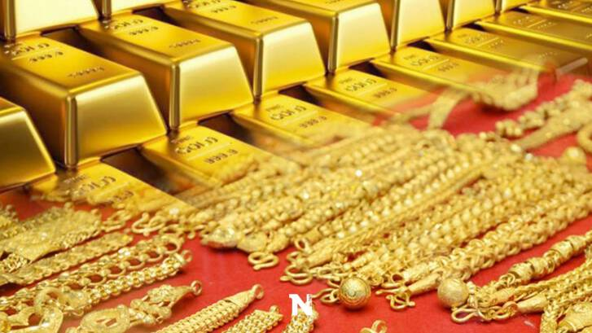

Slide 7
1. Metallic Standard
In the economic crisis situation, "gold price" tends to fluctuate continuously, causing many people to turn their attention to investing in gold widely nowadays.

Slide 8
Gold bars are gold produced by melting into bars. with square blocks Available from light to heavy type. starting from Weight less than 1 baht to weight tens of baht For this reason, gold bars are free of charge. But there will be a block or Premium value instead.
Generally, the price will be about 250 baht / gold bar weighing 1 baht. If you buy 5 baht or more, the block price will not be charged.
Gold bars can be divided into two types.
1. Gold bars without block value Gold bars without block value are gold bars that weigh from 5 baht up to the weight of kilograms. That doesn't have a beautiful decorative pattern, if there is a pattern, it will be just a small logo of the shop engraved on the gold bar. This type of gold is therefore popular to buy for investment especially.
2. Block-value gold bars A block-valued gold bar is a gold bar that weighs less than 5 baht, for example, gold weighing 4 baht, 1 salung, 1 gram, etc., or designs with various patterns, such as special festival designs. various items to buy as a special gift Given to important people on various occasions, this type of gold bar Therefore, it is more suitable for buying as a gift.

Slide 9
The advantages of gold bars
● Suitable to buy for investment
● Suitable for buying as a gift on special occasions
● No gold price commission.

Slide 10
Gold jewelry is "gold" that is formed into various forms. commonly used as ornaments to wear for beauty such as necklaces, rings, bangles and bracelets
In which each type of gold jewelry has a commission or labor fee of the goldsmith who designs and forms gold in each pattern. from gold bars to gold ornaments The commission depends on the difficulty of each type of gold jewelry.
* What are the commissions and blocking fees for? for example
If you already bought gold and want to bring gold back to sell We get the resale price lower than the purchase price. because the gratuity is not included and including the weight of borax that is part of the connection of gold ornaments

Slide 11
Advantages of gold ornaments
● Starting price is not high
● Can buy and keep for savings to start investing
● Can be worn as an accessory for beauty
Therefore, gold ornaments therefore not suitable for investmentBut suitable for wearing as jewelry or for saving money Buy-sell to increase the value during the price of gold as well.

Slide 12
In summary
the two types of gold are completely different.
Gold ornaments are suitable for Bring it as an accessory to wear. for beauty
that gold bar Suitable for those who want to buy gold for investment. speculation in the future, which
price of gold jewelry will be more expensive price of gold bars Because there must be a goldsmith's shaping fee. for different beauty according to difficulty
The selling price of gold bars is better. Will not be deducted for the solder, the commission. The reason why gold bars are cheaper than gold ornaments is because there is no commission charged. or wages for making gold But there will be a block or premium value which is cheaper than the commission of gold ornaments.

