Slide 1
Political Philosophy
Sunhanat Jakkapattarawong​

Slide 2
AGENDA
Political obligation and the origin of the state​
Middle age : Christian politics
​Niccolo Machiavelli
Social Contract theory
​Utilitarianism
Conservatism
​

Slide 3
Political obligation and the origin of the state
The concept of "state" or "power relations" has its formal origins in ancient Greece. Large city-states (polis) such as Sparta and Athens developed from hill forts. Athens was the most influential and has long been considered the cradle of democracy. Athens had a "direct" democracy in which all free male citizens (50,000) were eligible to vote. Women, slaves and foreigners were excluded. The foundations of Western philosophy also date from this period. Socrates, Plato, and Aristotle all attempted to answer the question at the heart of political philosophy and ethics: "How shall we live?" Today, most democratic countries operate under a representative system, such as Thailand, Canada, and the United Kingdom, in which voters elect a MP to represent them in Parliament. The party with the most deputies usually forms the government.

Slide 4
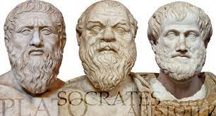
Ancient Philosopher
plato
SoCrates
Aeristotle

Slide 5
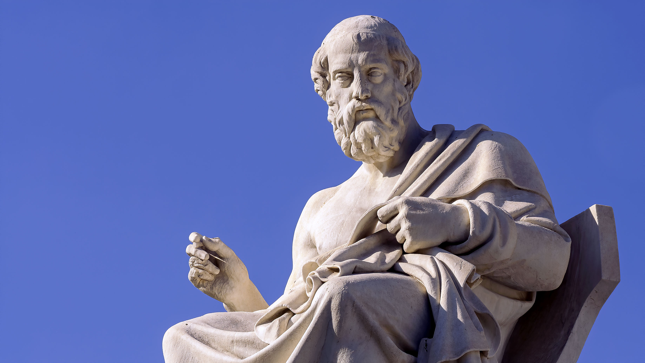
Plato Key Work: The Republic
Ideology: autocracy - rule of the philosopher-king, an enlightened dictator. Plato is famous for his criticism of alternative systems, especially Athenian democracy. The philosopher ruler has the authority to rule because of his genius and education. His perfect focus on truth (forms) makes him infallible. Quotes, "There will be no end to the troubles of states, indeed of mankind itself, until philosophers become kings in this world, or until those whom we now call kings and rulers really and truly become philosophers."

Slide 6
Plato’s Critique of Democracy
Simile of the ship – "The crew quarrels with each other as to how the ship should be steered, each thinking that he must be at the helm; they have never learned the art of navigation." (Critique of Authority in Democracy)Parable of the Great and Powerful Beast - "But he would not know which of the creature's preferences or desires were admirable or shameful; he would simply use the term on the basis of its reactions, calling what pleases it good, what annoys it bad." (Criticising the inability of the state to provide for the needs of the people in a democracy)

Slide 7
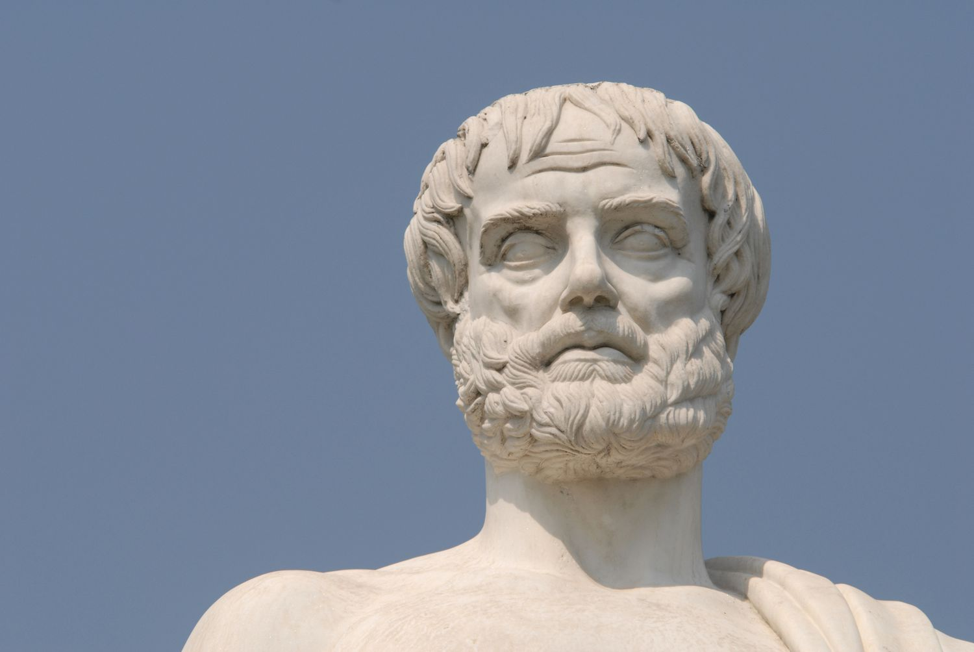
Aristotle Key Work: the Politics
Ideology: a virtuous monarchy is the highest form of government - he lists 6 types: 3 true (Monarchy, Aristocracy & Polity ) and 3 perverted ( Tyranny, Oligarchy & Democracy ). True states strive for virtue, perverted ones for personal power and wealth. The polis (state) is considered the highest source of ethical authority, but participation in politics is limited to male landowners. Only they have the time to develop the virtues, and therefore rightly have authority over those who are "naturally inferior." The family is considered the foundation of a stable society, as is adherence to laws and acceptance of the status quo - in this sense, he provides a foundation for conservative principles. Quotes, "Man is by nature a political animal." "Man perfected by society is the best of animals; he is the most terrible of all when he lives without law and without justice."

Slide 8
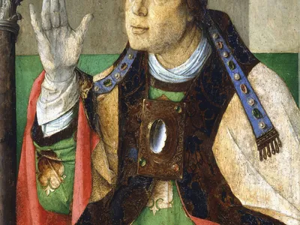
Middle age : Christian politics
Christian politics Following the Edict of Milan (313 AD), Christians were faced with the need to politicise themselves. Church and state became intertwined, and Christians had to grapple with how to behave toward the government and what to do in the face of foreign aggression. Many withdrew from public life because they believed it could only corrupt. In his book, "The City of God, Augustine argues that man cannot be fulfilled by living in the polis alone. Augustine demands that the government should be obeyed and that citizens should fight in just wars, but that Christians should focus beyond this life to "God's eternal kingdom."

Slide 9
Scholastic perspectives
Scholastic philosophers such as Thomas Aquinas challenged the Divine Right of Kings. A ruler deemed unjust and failing in his duties could be rightfully overthrown. Aquinas advocated the natural law theory, which states that humans can discover God’s will via use of reason. This supersedes the authority of Kings (e.g. of legitimate opposition to authority)“. . . this is the first precept of the law, that good is to be done and promoted, and evil is to be avoided. All other precepts of the natural law are based on this . . .”

Slide 10
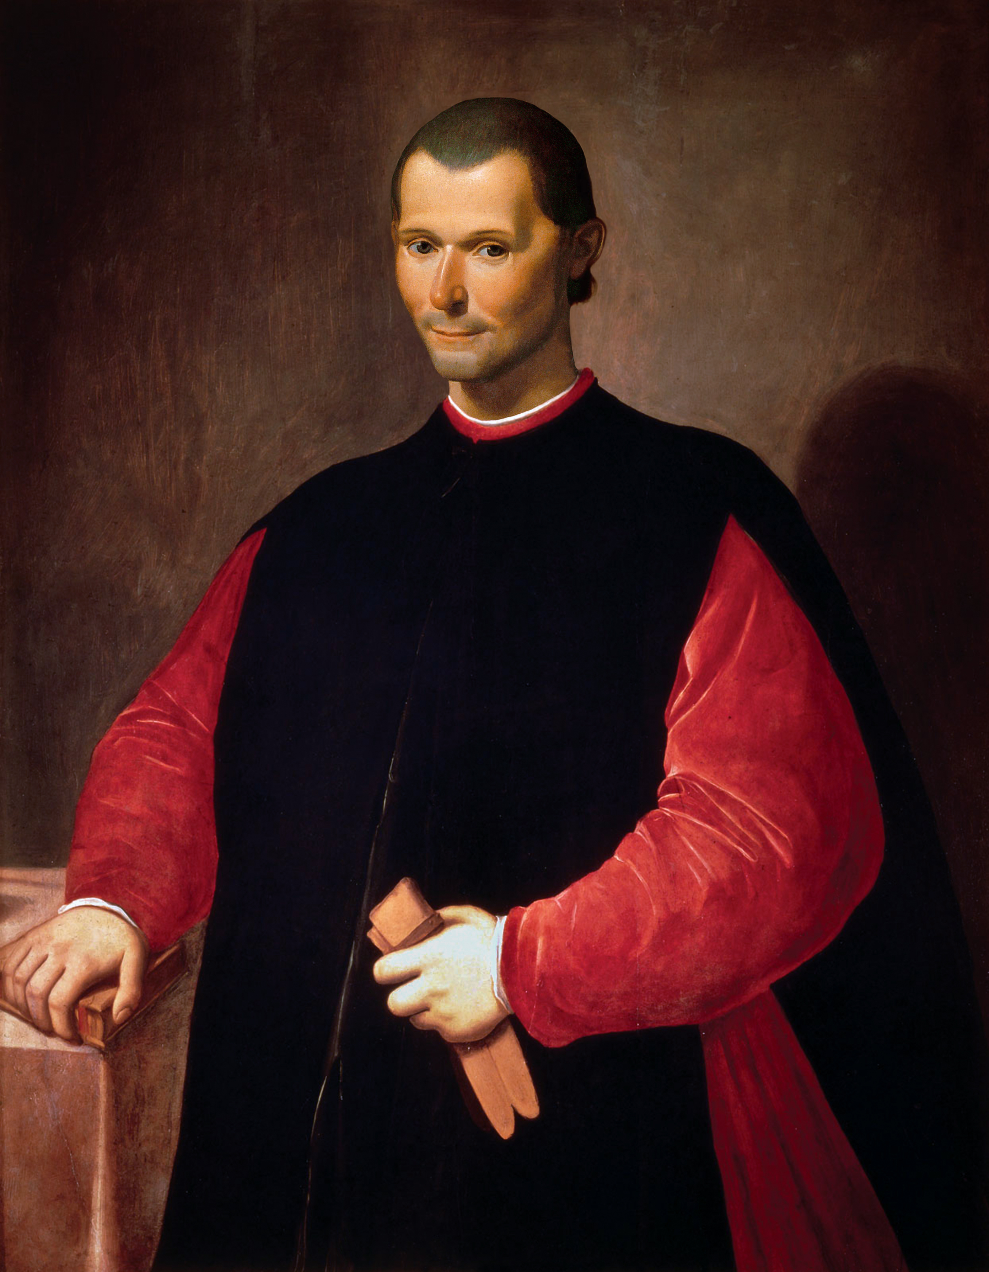
Niccolo Machiavelli (1469-1527)
Key Work: The Prince Ideology: in contrast to Plato, Aristotle, Aquinas and others, Machiavelli does not offer an ideology, rather he gives practical advice on how to obtain and preserve power. His seminal work is directed to new Princes, not hereditary ones, who will have to establish means to protect their position. It would be wrong, however, to assume that Machiavelli would sanction all manner of evil doing to achieve his ends. Cruel actions are instrumental to the preservation of power and must not be employed beyond what is necessary to achieve this objective.
Quotes: "He who establishes a tyranny and does not kill Brutus, and he who establishes a democratic regime and does not kill the sons of Brutus, will not last long."“…it is much safer for a prince to be feared than loved”

Slide 11
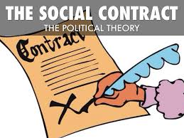
Social Contract theory
Under SCT, people give up some/all rights to a government and/or other authority in order to preserve social order & allow enrichment. Advocates of SCT include Plato, Mariana, Hobbes, Locke, Rousseau and Rawls. Agreement to the terms of the contract may be explicit (formal, individual approval), tacit (inferred from actions or statements) or hypothetical (based on our imagined reaction to the state of nature)Plato: members implicitly agree to the terms of the social contract by their choice to stay within the society (tacit agreement) – Socrates goes to his death on this principle. NB SCT can be viewed as a means of justifying obedience to the law and the authority behind it.

Slide 12
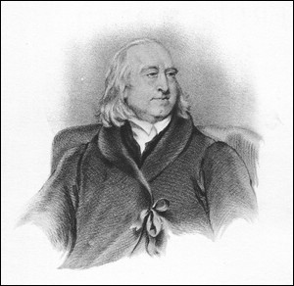
Bentham against Social Contract Theory
In his Fragment on Government (1776), Jeremy Bentham attacks Social Contract Theories on the basis that they rely on historical inaccuracy. There has never been a state of nature as described by Hobbes et al and such fiction has been used to support the submission of the masses and the legitimacy of monarchic government. As previously mentioned, the contract theorist’s reply to such an attack is that ideas referring to “the state of nature” are hypothetical. It is to be understood as a concept, not an historical event.

Slide 13
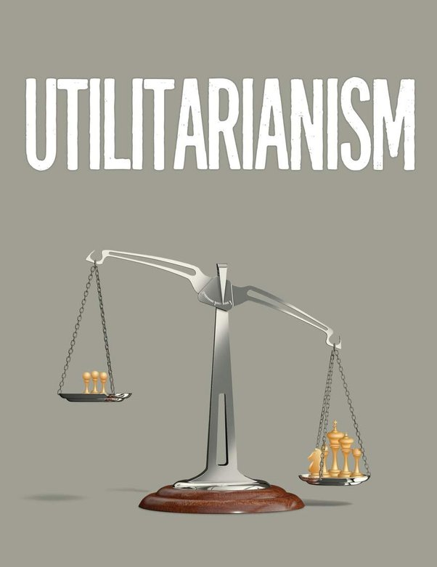
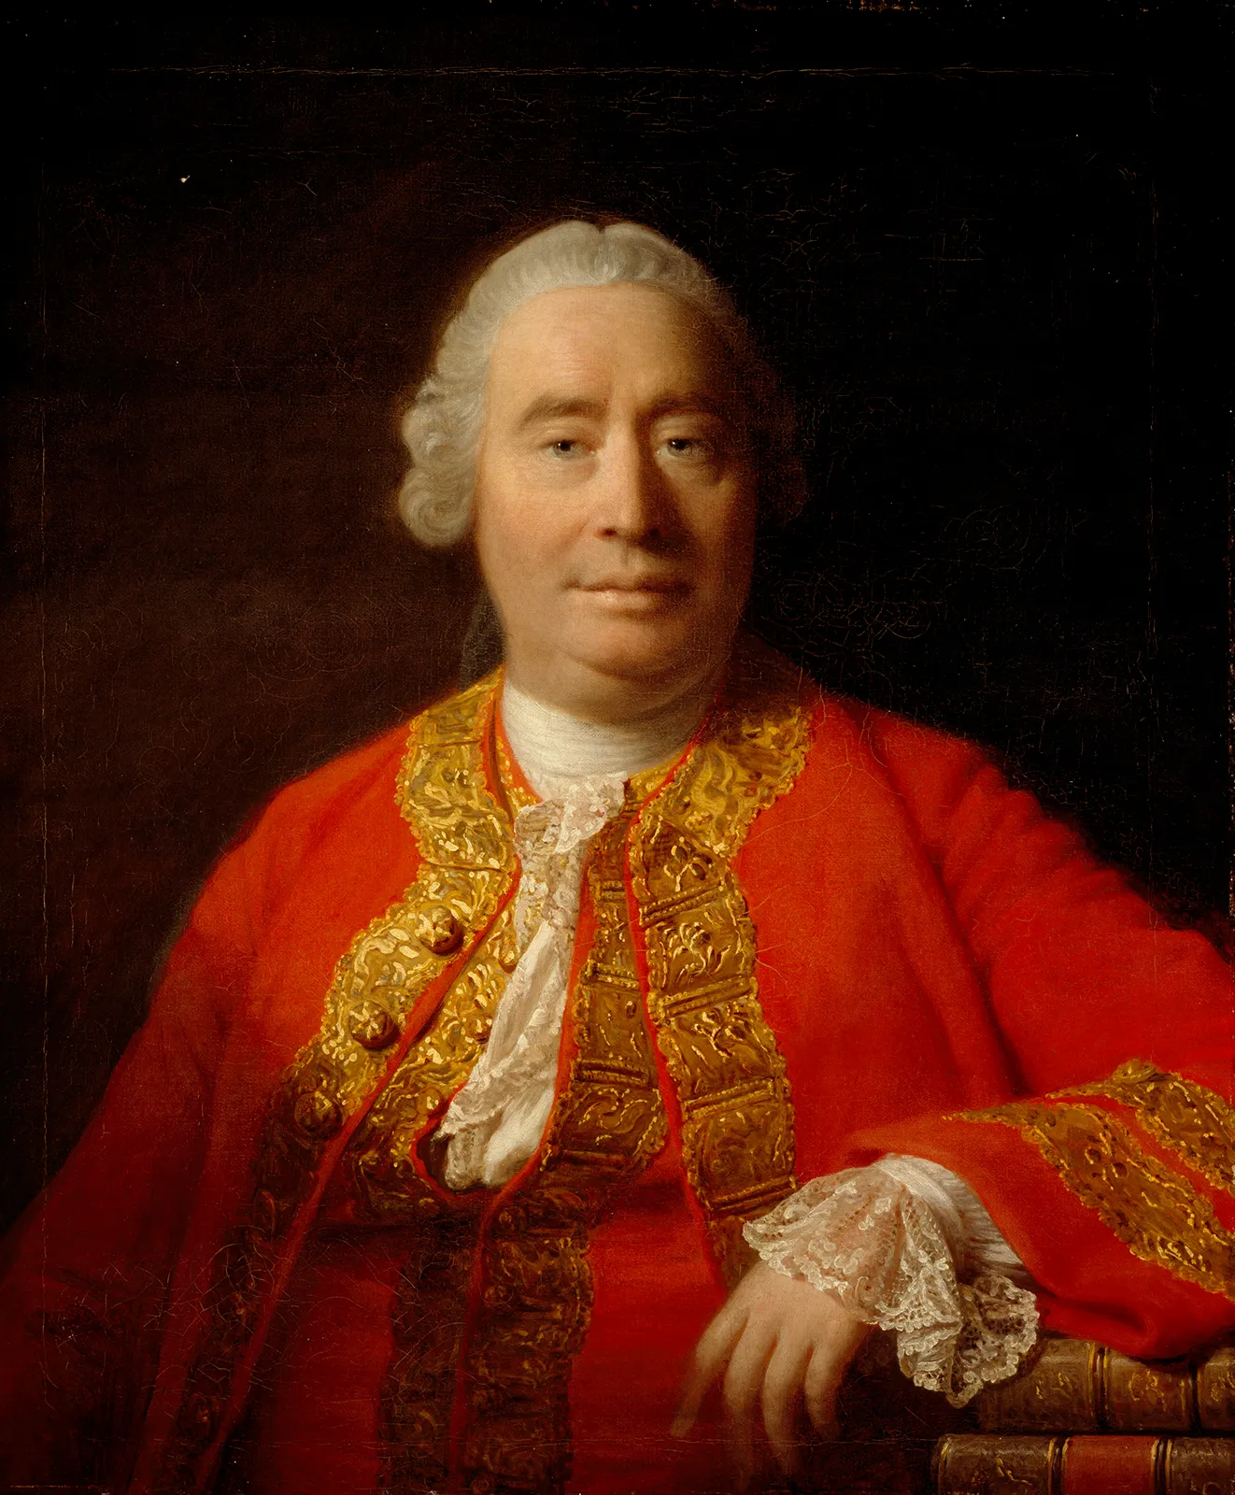
Utilitarian theories of government
David Hume first devised the idea of utilitarian systems of government. He claimed that governments were necessary, but that their justification is founded on their ability to produce a greater happiness than would be found without them (The Greatest Good for The Greatest #) Bentham popularised Utilitarianism, claiming that it is the system best suited to dealing with man’s innate selfishness – we are fundamentally driven by a desire to seek pleasure and avoid pain.

Slide 14
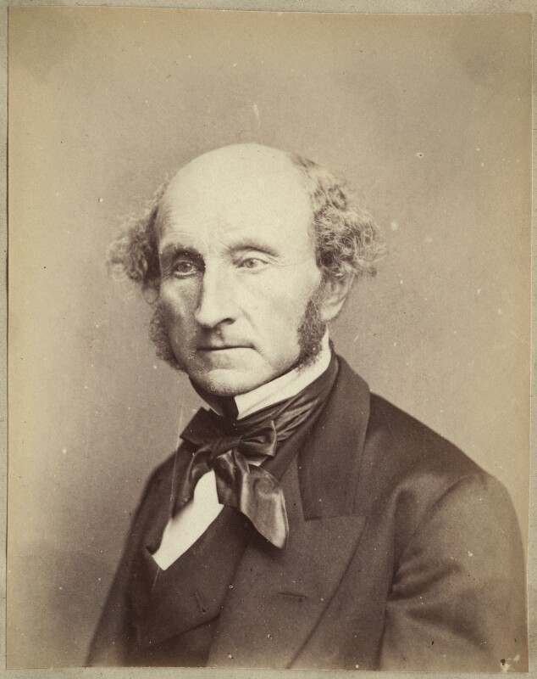
John S Mill’s Utilitarianism
Pinchin observes that Mill identifies 3 important questions in political philosophy: What authority exists for the good of the people? What process enables obedience? How can abuses of the authority be checked? In answer to all three, Mill believes that representative democracy provides the best response – this is favoured over direct democracy, which he saw as inefficient.

Slide 15
Utilitarianism & democracy
Utilitarianism is seen as the ideological thought that underpins democracy. The people inevitably vote for representatives who promise to implement that which would make them happy. The Government formed by a majority is thus elected on a utilitarian mandate. Here also Mill’s paternalism is evident - highly educated, middle-class professionals are better suited to rule than the majority of the public who are ill-informed and easily manipulated. (Sounds like Friedrich Nietzsche’s Superman). Yet, it is difficult to see how such a group could be said to represent the majority! Mill recognises this, but argues that participation in local government and institutions such as jury service will aid participation. Incidentally, Mill also argued that Utilitarianism would be favoured by God - who wishes that man be fulfilled.

Slide 16
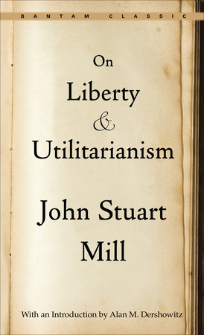
Utilitarianism & democracy
Mill’s alternative Mill disagreed, arguing that pleasures of the intellect are superior than base, physical pleasures. Thus, Opera is considered higher than billiards. Under this model, Utilitarianism appears less democratic and more elitist. We can obviously question why intellectual pleasures ought to be considered superior to physical ones. "It is better to be Socrates dissatisfied than a pig satisfied." [Utilitarianism]

Slide 17
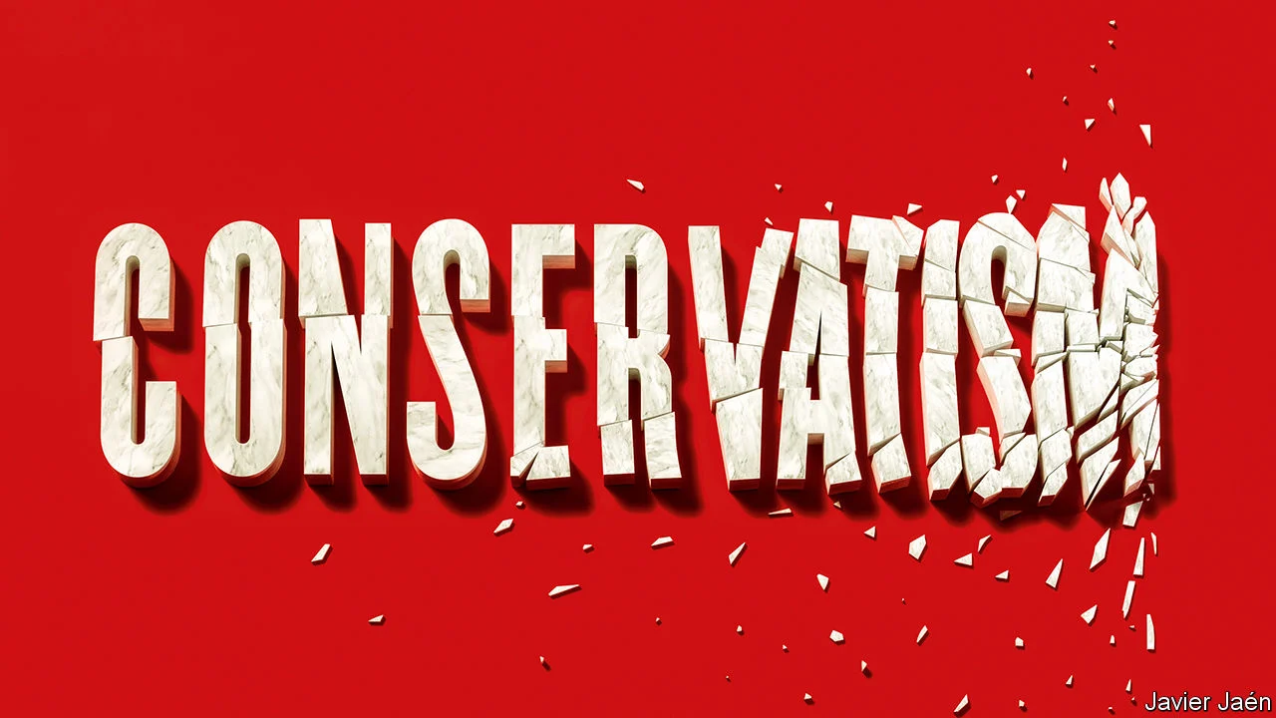
Conservatism
“
”

Slide 18
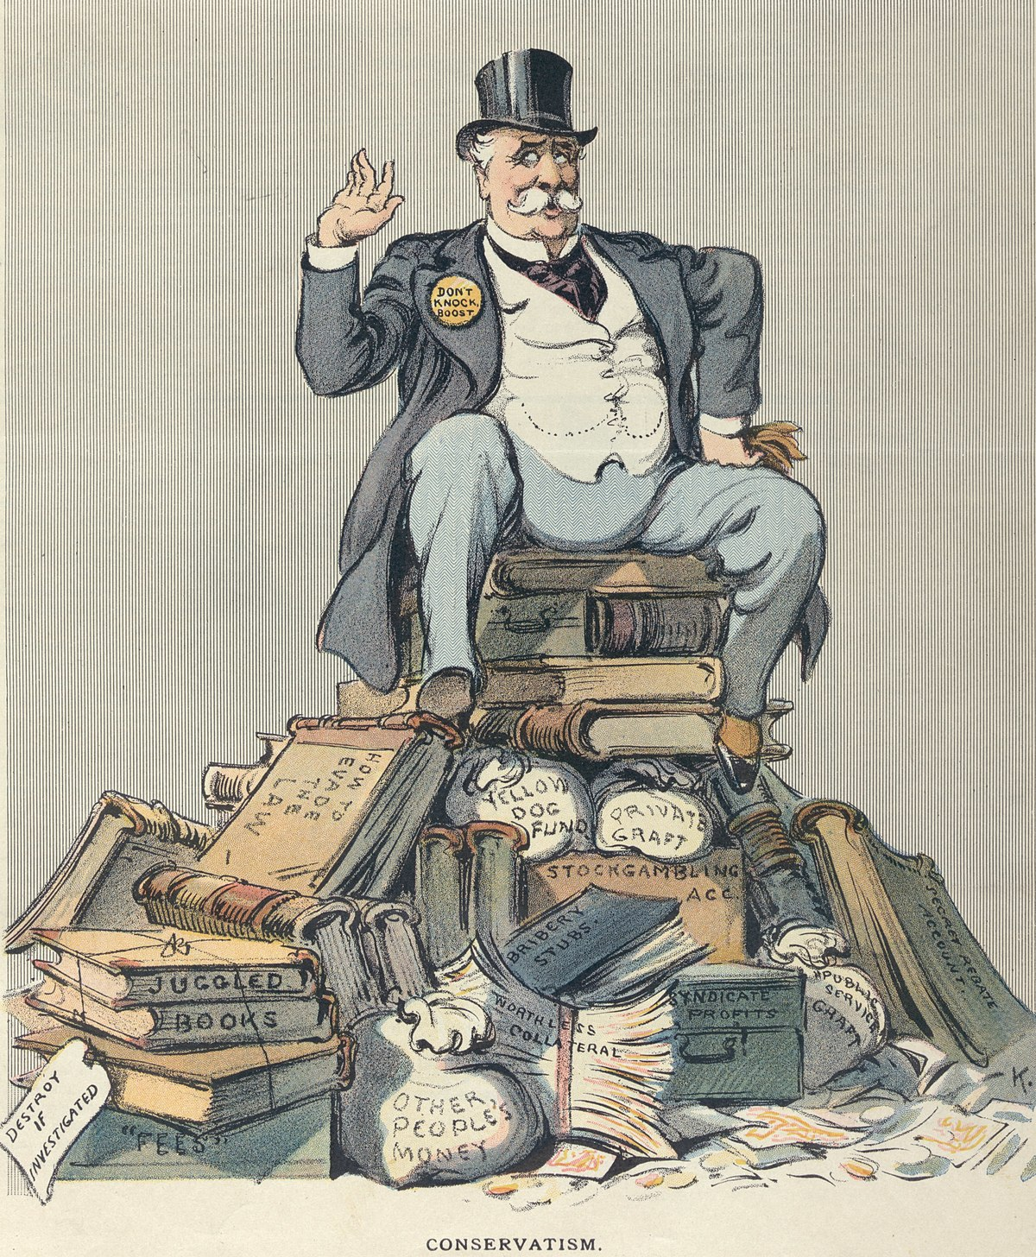
Conservatism
Conservatives are distinguished by their resistance to change, support for the free market economy, their faith in tradition and established institutions, a paternalistic view of the state (positive freedom) that is born of a negative diagnosis of human nature and a commitment to the rule of law.

Slide 19
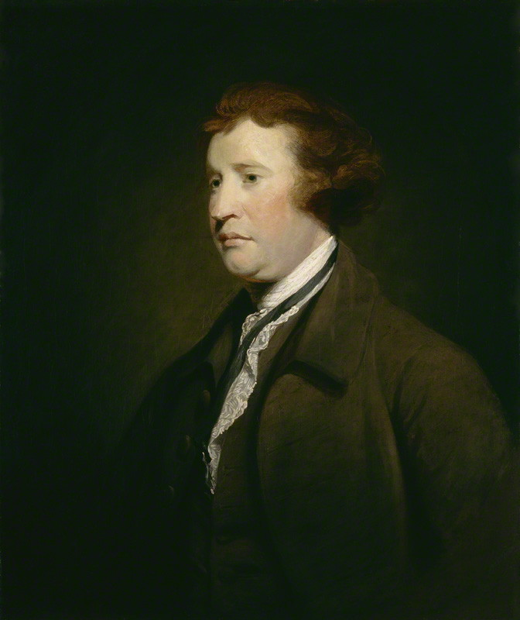
Edmund Burke
Key work: Reflections on the Revolution in France
Ideology: Conservative. The outbreak of the French Revolution in 1789 gave Burke his greatest target. Burke emphasized the dangers of mob rule, fearing that the Revolution's fervor was destroying French society. He appealed to the British virtues of continuity, tradition, rank and property and opposed the Revolution to the end of his life. He is justly regarded as one of the founders of the British Conservative tradition.
Burke Quotes “Good order is the foundation of all things.”
“All that is necessary for the triumph of evil is that good men do nothing.”

Slide 20
Epistemological scepticism
Burke’s conservatism is based on the belief that we cannot know all aspects of society. No one individual (or indeed, collective) has sufficient wisdom to surpass that which has been accumulated to create society as it is. Consequently, we can never justify wholesale change - rebellion is always to be discouraged. Change is acceptable, but only on a small scale that enables preservation of society. There are obvious problems with a system that is not prepared to accept the need to overhaul a brutal and oppressive regime. Anything would seem to be preferable to living under a dictator such as Pol Pot.

Slide 21
Open and Closed Societies
Burke advocates the closed society. This is a society where everyone knows their place (authoritarian and hierarchical). As Pinchin puts it “Your obligations follow from your agreed status; they are not questioned. ”In contrast, an open society is open to change. All authority must be justified and there is freedom to challenge. Unlike in the closed society, fact and value are considered distinct. Burke saw considerable danger in the open society. He feared the individualism that it breeds and believed that it would lead to chaos and moral vacuity (critics of the Charter of Rights say Trudeau ruined Canada in this way).

Slide 22
Law The rule of law is central to Burke’s conservative ideal.
Freedom is wholly dependent on the law. Without law, anarchy reigns and freedom to participate in society is destroyed. Burke saw anarchy as creating a political environment where might is right – those who have the greatest physical strength will suppress the weak. The law is inextricably linked to human history. To abolish it would be to abandon that which defines us. We would be cast adrift without a moral rudder(!)
RightsBurke felt can be no claim to “natural rights” other than those that have evolved in society. Any definition of “rights” outside society is dismissed as “intellectual fiction”. Rights are deemed relative to particular societies and will obviously differ within these societies. Consequently, the concept of “universal rights” was anathema to Burke.

Slide 23
THANK YOU

